Slide 1

Kiln Products Overview & Reporting API demonstration
A high-level overview of Kiln Validators & Kiln Widget
Secure | Scalable | Seamless
Presented by: Nestor Saavedra, Product Support Engineer
Date: 3/22/2025

Slide 2
The Problem: Staking Complexity
Running validators requires technical expertise & 24/7 monitoring.
Risks include slashing, downtime, and security vulnerabilities.
High infrastructure costs and operational overhead.
Regulatory & compliance complexities.
The solution: Kiln offers a fully managed, institutional grade staking solution.

Slide 3

WHAT ARE KILN VALIDATORS?
Enterprise grade staking infrastructure.
Fully managed validators so businesses don’t need technical know how.
Removes complexity for businesses & institutions.
Supports major Proof-of-Stake blockchains.

Slide 4
Why choose Kiln over other staking providers?
Feature | Kiln Validators | Other staking solutions
Fully managed service | Yes | No, often self managed
Institutional security | Yes | Varies
Slashing protection | Yes | Limited or Manual
Multi-chain support | Yes | Often single-chain
Automated rewards | Yes | Varies
The Kiln Advantage: Secure, Efficient, and Scalable

Slide 5
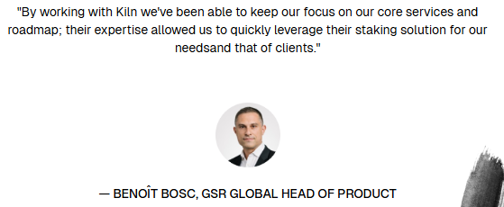

Who Benefits from Kiln’s Validator Infrastructure?
Institutions & Asset managers - Securely stake large holdings.
Crypto Exchanges - Offer staking services to customers effortlessly.
Custodians & Wallet providers - Add staking as a revenue-generating feature.
DAOs & Web3 Companies - Simplify staking without managing infrastructure.

Slide 6

From Staking Infrastructure to Seamless Integration
Kiln Validators solve the problem of running secure, high-performance staking nodes for institutions
But what if a business (like a wallet, exchange, or fintech app) wants to offer staking to its users, without deep blockchain expertise?
That’s where Kiln Widget comes in.

Slide 7

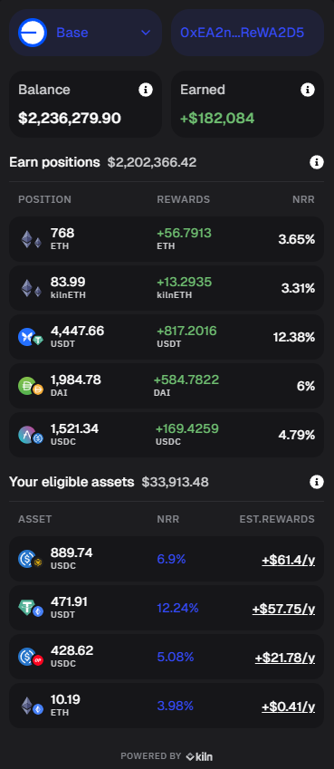
What is the Kiln Widget?
Kiln Widget: Plug-and-Play Staking for any business.
No-code staking solution -integrate in minutes.
Fully customizable UI - match your brand.
Mult-Chain support - stake across multiple blockchains.
Kiln-managed security - fully audited & monitored.

Slide 8
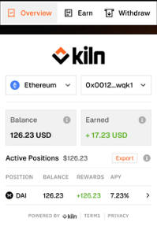
Why Businesses Love Kiln Widget
Kiln Widget VS. Building Your Own Staking Solution
Feature | Kiln Widget | Custom-Built Staking
Setup time | Less than a day | Months of dev work
Security | Fully managed | Self-managed risks
Compliance-ready | Yes | Requires legal & Security audits
Blockchain support | Multi-Chain | Often single blockchain
Customization | Yes (UI, Branding) | Requires extensive work

Slide 9
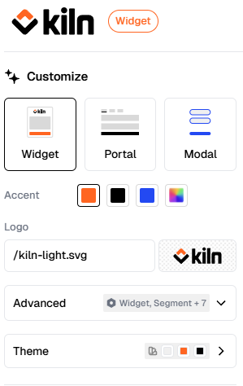
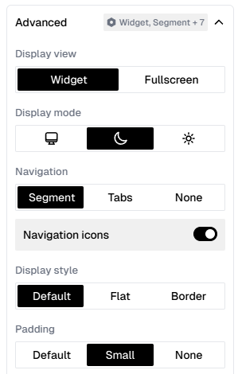
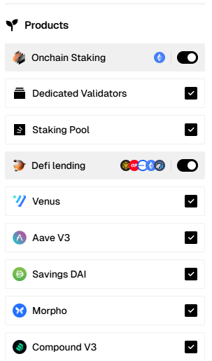
Kiln Widget Editor Customization
Advanced branding and color customization to match your exact visual identity.
Logo and theme adjustments (dark mode, light mode, and more).
Flexible layout and typography controls, including fonts, padding, and spacing.
Simple, secure exporting via branded integration links or easy-to-use JSON configuration files.

Slide 10




Use Cases for Kiln Widget
How Businesses Use Kiln Widget
Crypto Wallets - Add staking for users in less than a day
Exchanges - Offer staking to customers without building an in-house system
Fintech Apps - Monetize staking with minimal effort
DAOs & NFT Platforms - Enable staking rewards for token holders

Slide 11
Why Kiln?
Kiln makes staking simple, secure & scalable.
Kiln Validators – Fully managed staking infrastructure for institutions
Kiln Widget – No-code staking integration for business
Trusted by leading Web3 companies
Multi-chain support for maximum flexibility
Simple integration for businesses

Slide 12
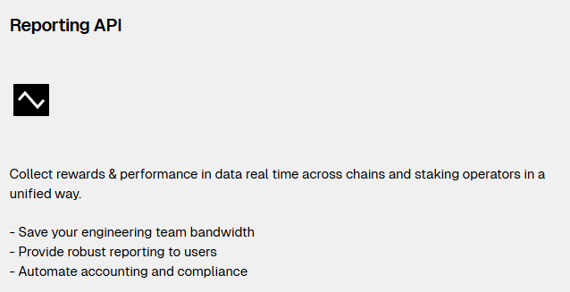
Kiln Reporting API: Performance Comparison

Slide 13
What are we comparing?
Compared performance (APY) of Kiln vs Non-Kiln validators on Holesky testnet.
Based on two clusters of 50 validators, each identified by withdrawal credentials.
Focused on:
CL APY (Consensus Layer)
EL APY (Execution Layer)
Total rewards/Gross APY

Slide 14
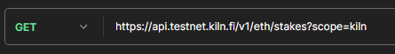
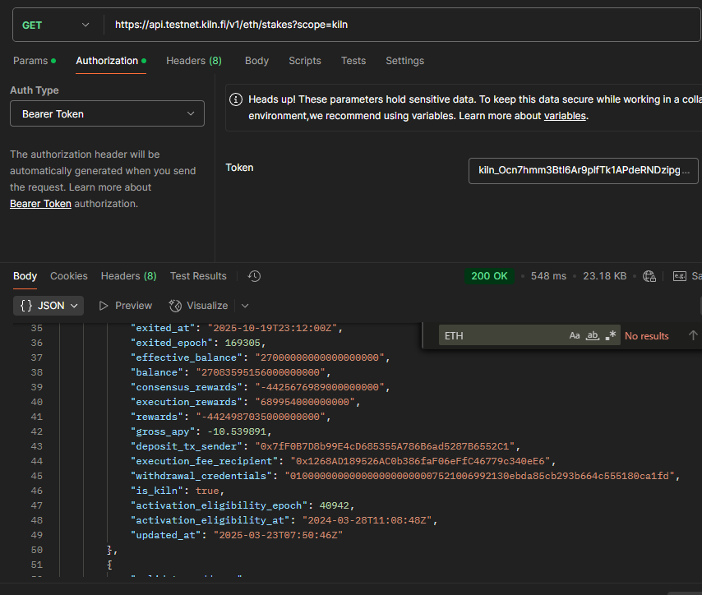
How I gathered the data?
Used Kilns reporting API to fetch validator data.
Cluster 1: ‘scope=kiln’ to filter Kiln-managed validators.
Cluster 2: Non-Kiln validators using known withdrawal credential: ‘Address’.

Slide 15
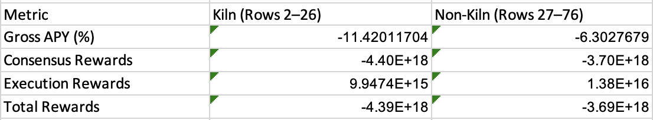
Cluster Comparison Summary
Clusters have negative Gross APY.
Consensus rewards are negative, which brings down total rewards.
Execution rewards remain positive for both clusters.

Slide 16
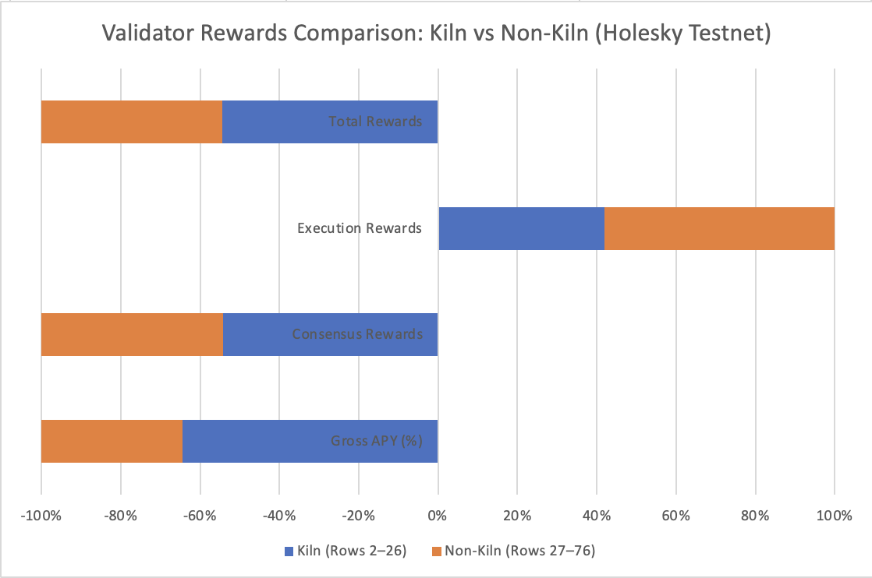
Performance Comparison
Kiln had higher negative APY.
Execution rewards were positive for both.
Holesky tesnet issues may explain negative results.

Slide 17
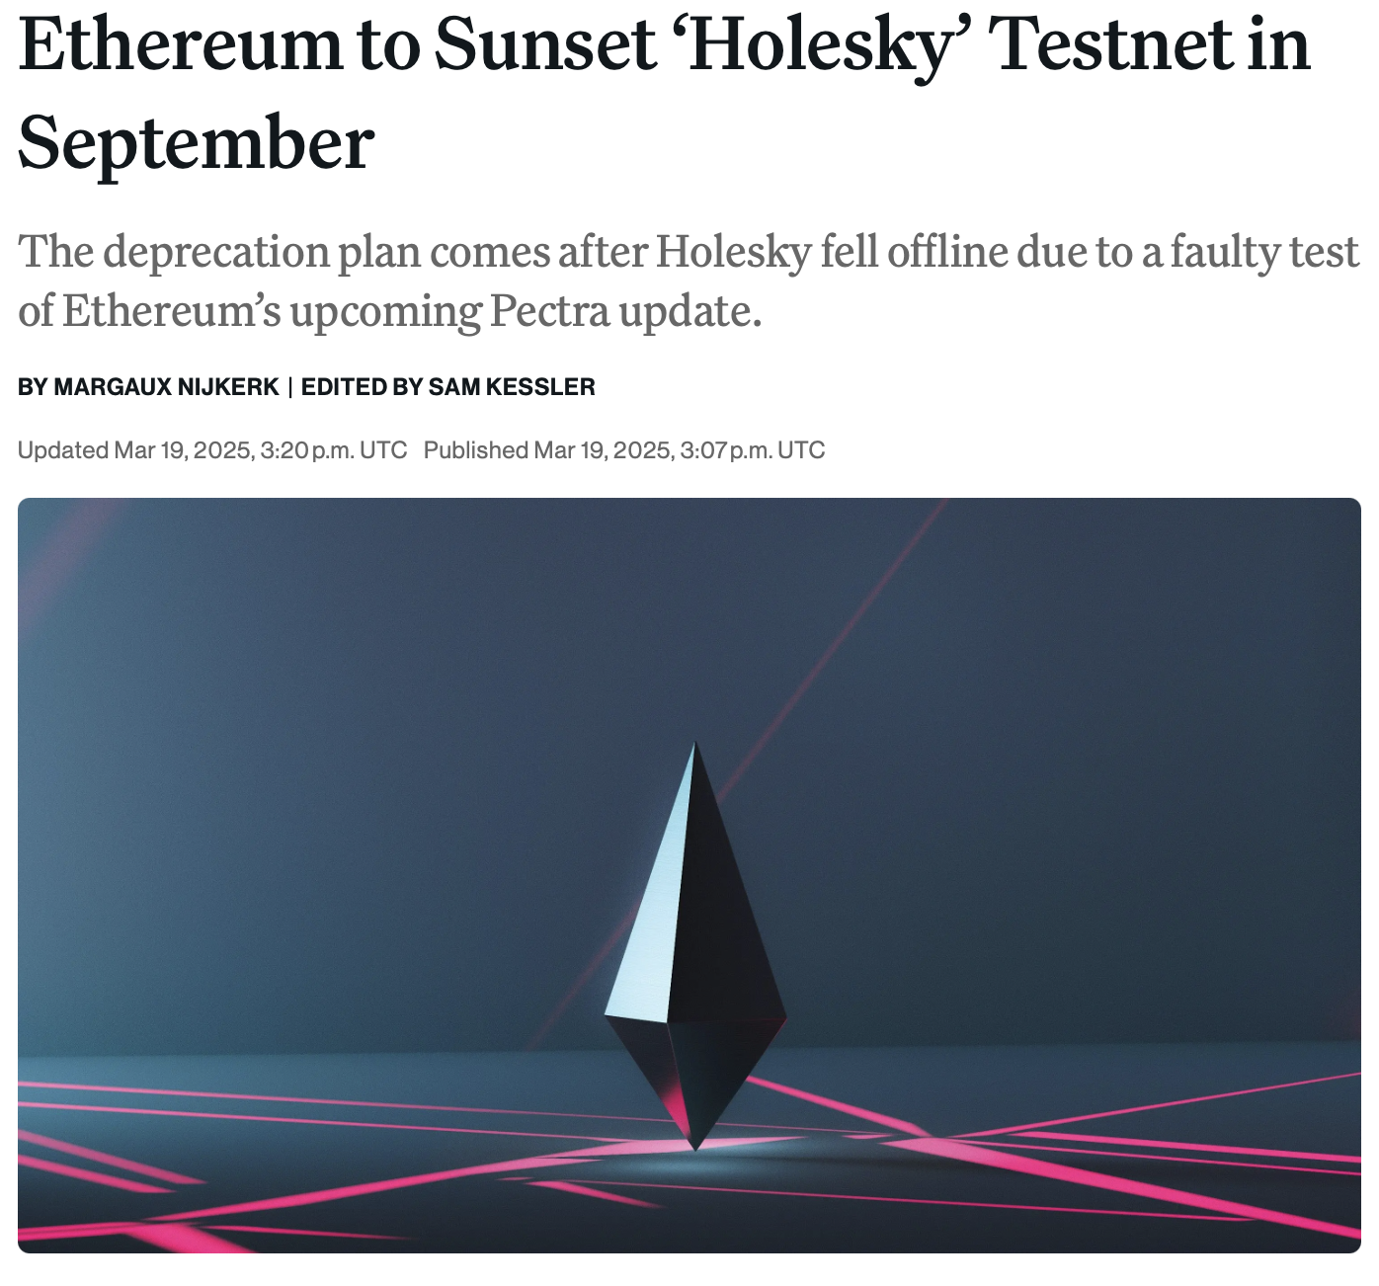
What does this tell us?
Both clusters show negative consensus rewards due to Holesky winding down.
Kiln validators had more negative APY, but likely due to being in active exiting state.
Execution rewards remained positive, indicating validator activity still produced value.

Slide 18
How Customers Can Use This
Kiln’s API provides deep visibility into validator performance.
Easy to filter by role(‘scope=kiln’), status, or rewards metrics.
While Holesky limits ideal APY comparison, this exercise shows how clients can run custom data-driven performance reports at scale.
Output can be added to dashboards or analytics pipelines.

Slide 19
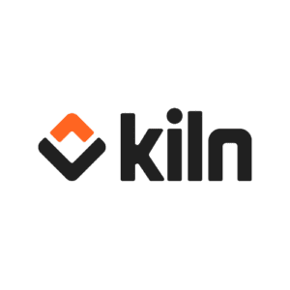

Thank you
Nestor Saavedra
saavfox@gmail.com
Saavtec.com

